Slide 1
MY MS FAMILY

Slide 2
Have You Been Diagnosed with Multiple Sclerosis?
Are you feeling overwhelmed?
Would you like to speak with people who understands how you are feeling?
My MS Family is a group of individuals living with or caring for someone living with multiple sclerosis. We host several support group across York Region and the surrounding areas. We hold these sessions in person as well as virtually for those who are unable to attend. Sessions are open to those living with MS and to their families.

Slide 3
WHAT IS MS?
Multiple Sclerosis (MS) is currently classified as an autoimmune disease of the Central Nervous System (brain and spinal cord).
The disease attacks the body’s myelin, which is the protective covering of the nerves, causing inflammation and often damaging the myelin.

Slide 4
MS SYMPTOMS
Myelin is necessary for the transmission of nerve impulses through nerve fibers.
When you have multiple sclerosis, the damaged myelin can cause symptoms such as extreme fatigue, weakness, lack of coordination, tingling, impaired sensations, vision problems, bladder issues, cognitive impairment and mood changes.

Slide 5
The effects of MS can be physical, emotional and financial.
Notes:
Photo by Power Point Stock

Slide 6
Currently there is NO CURE! Each day researchers are learning more about what causes MS and are finding ways to prevent it or at least slow down the progression of MS!

Slide 7
Canada has the highest rate of MS in the world.
And York Region has the highest rate in Ontario

Slide 8
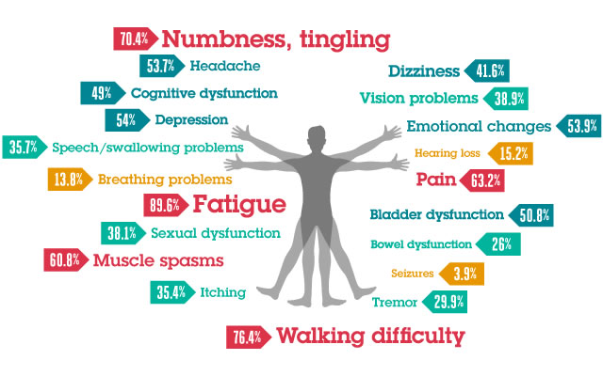
Symptoms Of MS
Not all MS symptoms
are present in those living with MS. No two people living with MS are identical. This is why it is so difficult to treat the different forms of MS.

Slide 9
HOPE-KNOWLEDGE-RESEARCH-CURE
Managing MS is an ongoing process beginning with the very first symptoms and continuing throughout the course of the disease. It’s never too soon or too late to think about how to access quality, comprehensive, interdisciplinary care.
Notes:
Photo by Karsten Winegeart on Unsplash

Slide 10
HOPE-KNOWLEDGE-RESEARCH-CURE (Cont’d)
Knowing what to look for, where to find it, and how to work effectively with your doctor and other health care professionals is essential to your health, wellness and quality of life.

Slide 11
Treatment Options
We do our best to support the physical and emotional effects of MS!
Notes:
Photo by Power Point Stock

Slide 12
Fundraising Efforts to Generate Funds
MY MS FAMILY COMMUNITY hosts many types of fundraising events to generate much needed funds.

Slide 13
We will use the funds to support MS Patients
These funds subsidize the purchase of accessibility equipment hospital beds, walkers, wheelchairs support bars, railings and stair lifts.
Notes:
Photo by Power Point Stock

Slide 14
Support from Government Agencies
MY MS FAMILY will also reach out to several government agencies to ease the financial burdens that are faced by many people living with MS.

Slide 15
Help us fight to end MS!
As a volunteer organization, we need you in our community to contribute your time and effort to assist us in fundraising and providing services.

Slide 17
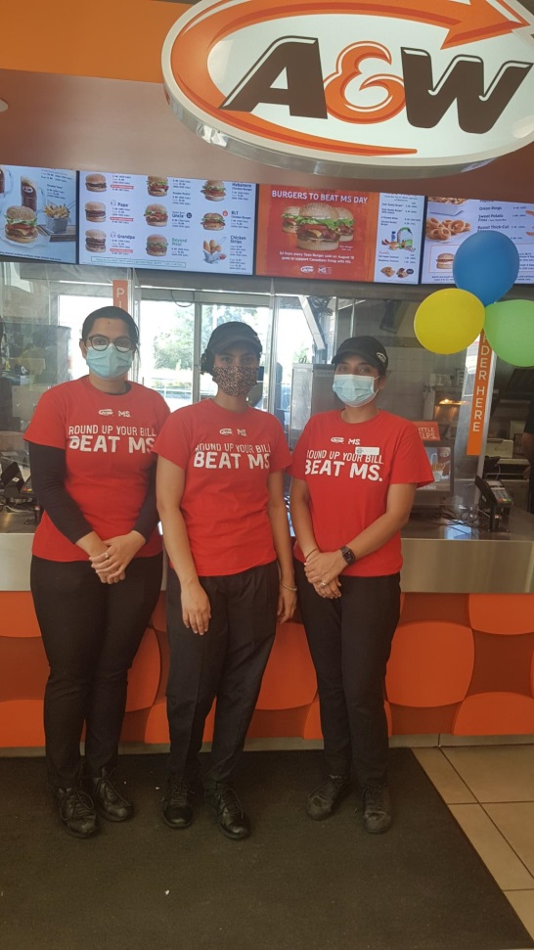
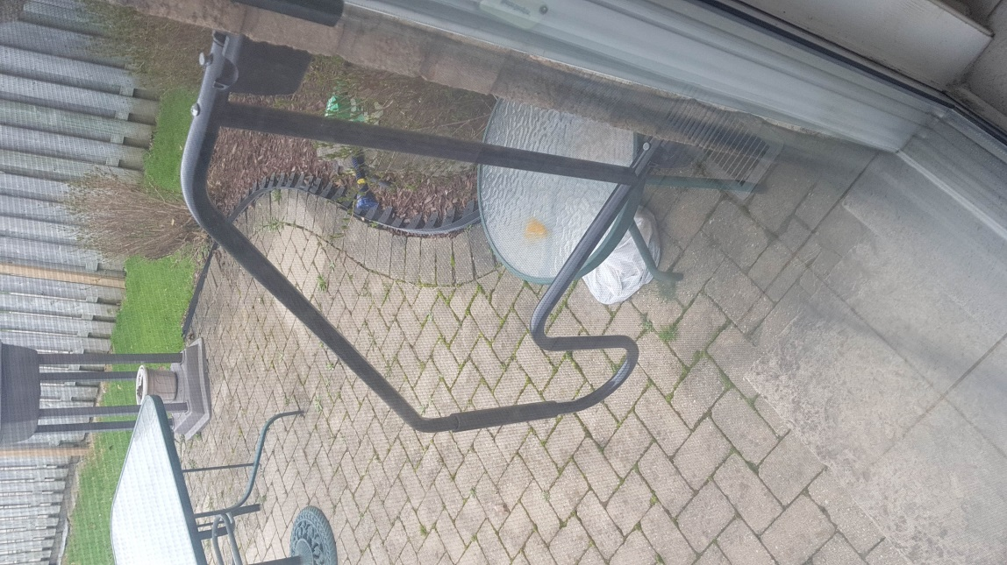

Slide 18
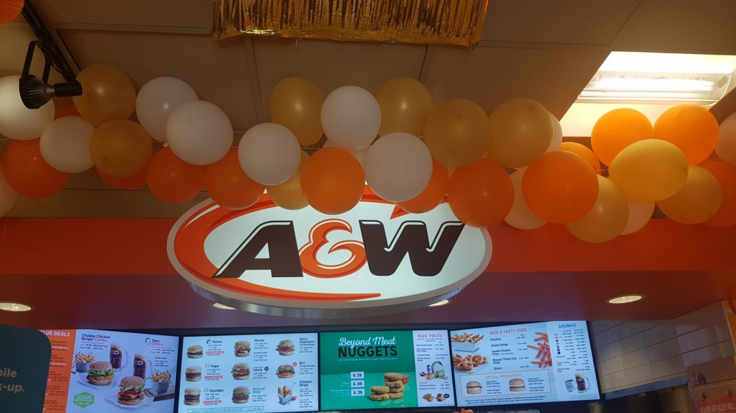
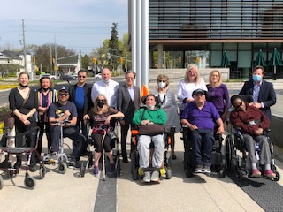
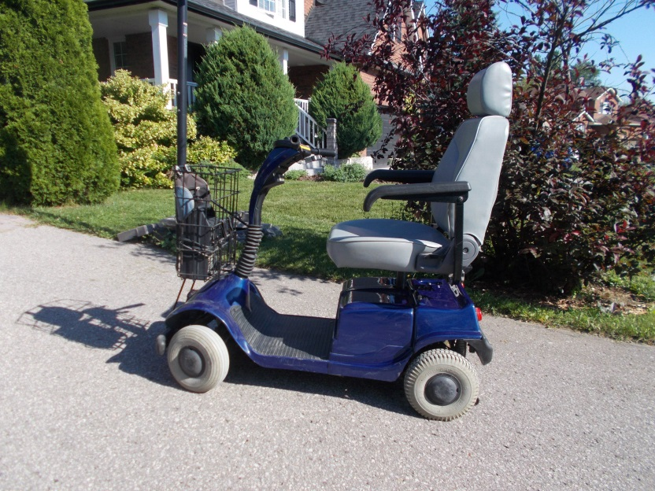

Slide 19
MY MS FAMILY CARES!
For more information
Email: info@mymsfamily.com
Website: MyMSFamily.org
Facebook, Twitter and Instagram: #MyMSFamily

