Slide 1
The Right to Accessibility
A Presentation by MY MS FAMILY

Slide 2
A disability is a physical or mental condition that limits a person’s movements, senses, or activities. The AODA uses the same definition of disability as the Ontario Human Rights Code.
Definition of Disability

Slide 3
Definition of Accessibility
The quality of being easily reached, entered, or used by people who have a disability.
Many architects believe that accommodating wheelchairs is all there is to providing accessibility. Those living with a disability would disagree!

Slide 4
The Right to Accessibility
All Canadians have the right to take part fully in society. Advancing accessibility is about creating barrier-free communities, workplaces and services for all Canadians. This is especially important to the more than 6 million Canadians, aged 15 and over, who have a disability.

Slide 5
Accessible Canada Act
The resulting Accessible Canada Act is landmark federal legislation that aims to realize a barrier-free Canada by 2040.
A key principle of the ACA is “Nothing Without Us”, which means that persons with disabilities should be consulted when developing laws, policies and programs that impact them. In keeping with this principle, the Government of Canada works with persons with disabilities, and organizations who advocate on their behalf, to better understand the full diversity of the community it serves.

Slide 6
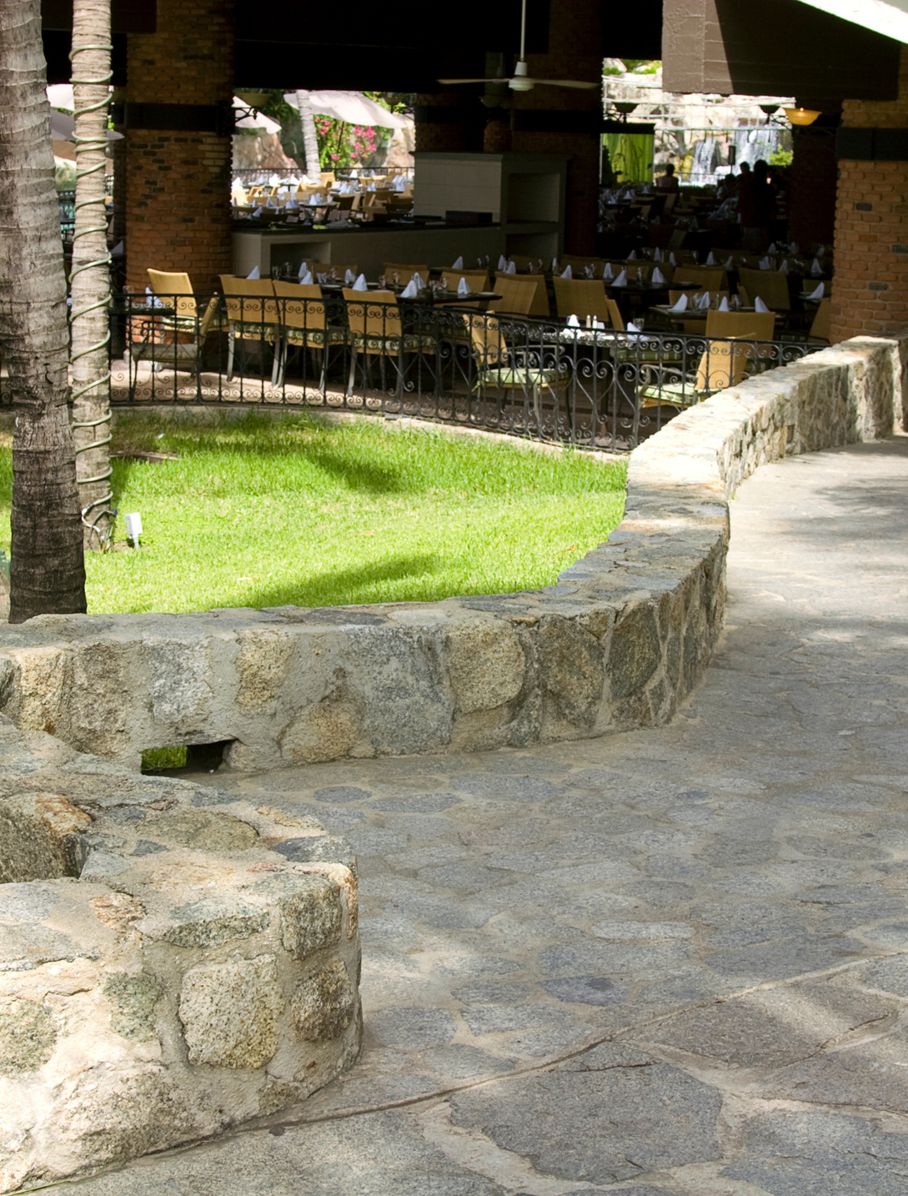
Accessibility refers to the design of products, devices, services, or environments for people who experience disabilities. Ontario has laws to improve accessibility for people with disabilities, including the Accessibility for Ontarians with Disabilities Act (AODA), the Ontario Human Rights Code, and the Ontario Building Code.
More Legislations

Slide 7
The Accessibility for Ontarians with Disabilities Act (AODA) seeks to ensure that all Ontarians have fair and equitable access to programs and services and to improve opportunities for persons with disabilities. The Act address barriers in Customer Service; Information and Communication; Employment; Transportation; the Design of Public Spaces.
Accessibility for Ontarians with Disabilities Act

Slide 8
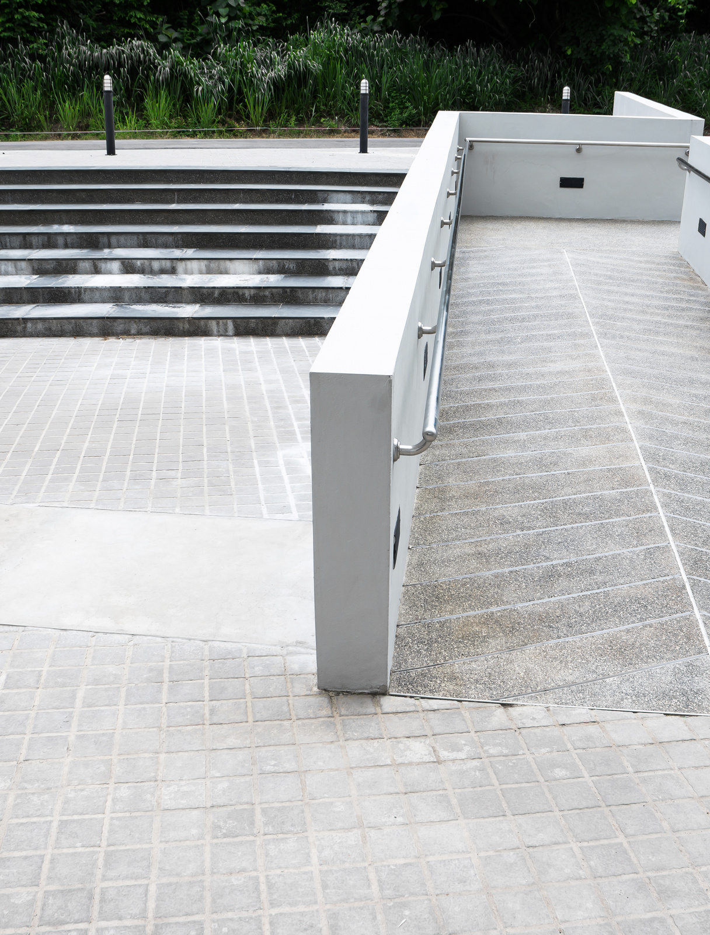
The AODA has five Standards which are included in the Integrated Accessibility Standards (IASR). These include the Customer Service Standard; Employment Standard; Information and Communication Standard; Design of Public Spaces Standard; the Transportation Standard; as well as some general requirements.
Integrated Accessibility Standards Regulations

Slide 9
The Act operates by bringing accessibility standards into regulation. Accessibility standards are laws that individuals, government, businesses, non-profits, and public sector organizations must follow in order to become more accessible. The accessibility standards contain timelines for the implementation of required measures and help organizations identify, remove, and prevent barriers in order to improve accessibility for people with disabilities.
Accessibility Standards

Slide 10
The Building Code Act is the legislative framework governing the construction, renovation and change-of-use of a building. The Ontario Building Code (OBC) is a regulation under the Act that establishes detailed technical and administrative requirements as well as minimum standards for building construction. The Act was amended on January 1, 2015 to include requirements that enhance accessibility in newly constructed buildings and existing buildings that are to be extensively renovated.
Ontario Building Code

Slide 11
A barrier is a circumstance or obstacle that keeps people apart. For people with disabilities, barriers can take many forms, including attitudinal, communication, physical, policy, programmatic, technological, social, and transportation
Barriers to Accessibility

Slide 12
Accessibility Shortcomings
7 Cases to remember

Slide 13
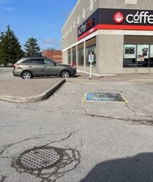
Case #1 - Parking Issue
This design of the ramp adjacent to the accessibility parking spot is a dangerous design. As you can see the person using the wheelchair or walker will need to travel into traffic in order to access the ramp. There is a ramp in front of the spot but it will be blocked by the vehicle.

Slide 14
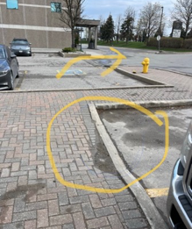
Case #2 - Parking Issue
Here are more dangerous and illegal parking issues. You can see the accessible parking spot beside the fire hydrant and the ramp is around the other side of the sidewalk parking spot. When the vehicle parks in that vacant spot therefore no access to the ramp. There is no accessible parking spot where the ramp is located.

Slide 15
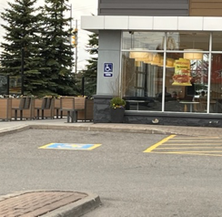
Case #3 - Parking Issue
In this slide it’s the most reasonably designed accessibility parking spot the only issue is the narrow sidewalk that could cause issues with powered wheelchairs and walkers.

Slide 16
Case #4 - Parking Issue
Here is another dangerous situation. This picture was taken next to accessibility parking spot but the ramp is a distance away into traffic. One ramp at the Stop sign and the other ramp next to Allstate office. As you can see travelling into traffic! Why can there not be a ramp system along that entire side.

Slide 17
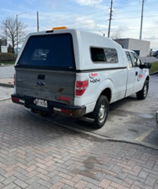
Case #5 - Parking Issue
As you see the pick-up is parked in a parking spot and the accessibility parking spot is next to it How does one in a wheelchair or walker able to access the ramp in order to get onto the sidewalk. The other issue in this picture is the sidewalk brick format is difficult for walkers and those using cans to travel over…due to uneven and bumpy travelling.

Slide 18
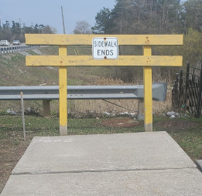
Case #6 - Dead End Sidewalk
This is a common daily situation for most living with a disability!

Slide 19
Case #7 - Unconducive Push Button
The push button door openers are not conducive to those with dexterity issues. The best design is hands free, wave type design.

Slide 20
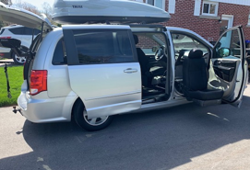
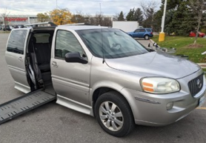
Van Exit Configuration
Types of Accessibility Vans with different exit points

Slide 21
Other Accessibility Shortcomings
There are so many other accessibility barriers such as:
Powered doors opening towards the push button openers
The length of time of doors remaining open as one passes through the door way using wheelchair walker and cane.
Cross walk lights the length of time to cross multi lane roads
The height of the ramps at times too steep for manual wheelchairs
Uneven sidewalks and at times lacking of sidewalks along busy streets.
Mobility Transportation scheduling and availability
Washroom access doors and stalls and wash basins

Slide 22
•Towards an Accessible Canada - Canada.ca
•Accessibility in Ontario | ontario.ca
•Accessibility in the public service - Canada.ca
•All photo’s taken by MY MS FAMILY members
Footnotes

