Slide 1
The Right to Accessibility
A Presentation by MY MS FAMILY
Notes:
In the next 5 to 10 years a very large portion of the population will be in their senior years and will be facing many of the accessibility shortcomings. We need to act now because when called upon for services Society will not be ready.

Slide 2
Definition of Disability
A disability is a physical, mental or emotional condition that limits a person’s movements, senses, or activities. The Accessibility for Ontarians with Disabilities (AODA) uses the same definition of disability as the Ontario Human Rights Code.

Slide 3
Definition of Accessibility
The quality of being easily reached, entered, or used by people who have a disability. Many architects believe that accommodating wheelchairs is all there is to providing accessibility. Those of us living with a disability would disagree!

Slide 4
Our Right to Accessibility
All Canadians have the right to fully take part in society. Accessibility is about creating barrier-free communities, workplaces and services for all Canadians. There are more than 6 million Canadians, aged 15 and over, who have a disability.
Notes:
People living with a disability are part of society even though some may think differently, and this is another issue that we face on a daily basis.

Slide 5
Accessibility Acts and legislations
Accessible Canada Act (ACA)
Accessibility for Ontarians with Disabilities Act (AODA)
Integrated Accessibility Standards Regulations
PROVINCIAL Legislation
Accessibility Standards
Ontario Building Code
Notes:
ACA - The resulting Accessible Canada Act is landmark federal legislation that aims to realize a barrier-free Canada by 2040.
A key principle of the ACA is “Nothing Without Us”, which means that persons with disabilities should be consulted when developing laws, policies and programs that impact them. In keeping with this principle, the Government of Canada works with persons with disabilities, and organizations who advocate on their behalf, to better understand the full diversity of the community it serves.
AODA- The Accessibility for Ontarians with Disabilities Act (AODA) seeks to ensure that all Ontarians have fair and equitable access to programs and services and to improve opportunities for persons with disabilities. The Act address barriers in Customer Service; Information and Communication; Employment; Transportation; the Design of Public Spaces.
IASR - The AODA has five Standards which are included in the Integrated Accessibility Standards (IASR). These include the Customer Service Standard; Employment Standard; Information and Communication Standard; Design of Public Spaces Standard; the Transportation Standard; as well as some general requirements.
Accessibility Standards - The Act operates by bringing accessibility standards into regulation. Accessibility standards are laws that individuals, government, businesses, non-profits, and public sector organizations must follow in order to become more accessible. The accessibility standards contain timelines for the implementation of required measures and help organizations identify, remove, and prevent barriers in order to improve accessibility for people with disabilities.
Ontario Building code - The Building Code Act is the legislative framework governing the construction, renovation and change-of-use of a building. The Ontario Building Code (OBC) is a regulation under the Act that establishes detailed technical and administrative requirements as well as minimum standards for building construction. The Act was amended on January 1, 2015 to include requirements that enhance accessibility in newly constructed buildings and existing buildings that are to be extensively renovated.

Slide 6
Accessibility shortcomings
7 cases to Remember
Notes:
These next few slides are examples of major issues that we with mobility issues face and the dangers that are present that should never of been designed.

Slide 7
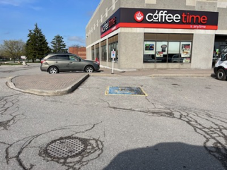
Case #1 - Parking Issue
This design of the ramp adjacent to the accessibility parking space is a dangerous design.
As you can see, any person using a wheelchair or walker will need to travel into traffic to access the ramp.
There is a ramp in front of the space, but it will be blocked by the vehicle.

Slide 8
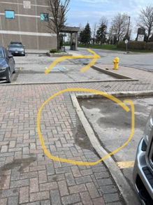
Case #2 - Parking Issue
Here are more dangerous and illegal parking issues.
You can see the accessible parking spot beside the fire hydrant, but the ramp is around the other side of the sidewalk.
When a vehicle parks in that vacant spot there will be no access to the ramp.
Furthermore, there is no accessible parking spot where the ramp IS located.

Slide 9
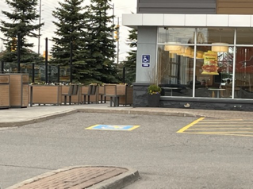
Case #3 - Parking Issue
In this slide you see what looks like the most reasonably designed accessibility parking spot.
The problem is the narrow sidewalk that could cause issues with powered wheelchairs and walkers.

Slide 10
Case #4 - Parking Issue
Here is another dangerous situation.
This picture was taken next to an accessible parking spot, but the ramp is a distance away into traffic.
One ramp at the Stop sign and the other ramp next to Allstate office. As you can see travelling into traffic!
Why can there not be a ramp system along that entire side?

Slide 11
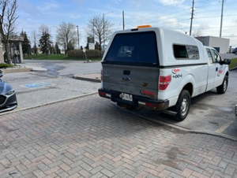
Case #5 - Parking Issue
As you see the pick-up is parked in a parking spot and the accessibility parking spot is next to it.
How does one in a wheelchair or walker able to access the ramp to get onto the sidewalk?
The other issue is the sidewalk brick format that is uneven and bumpy for people using walkers, canes or having balance issues to travel over.

Slide 12
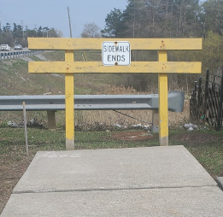
Case #6 - Dead End Sidewalk
“Sidewalk Ends?”
This is a common daily occurrence for most living with a disability!
Barriers are everywhere. Most are just not anywhere near this obvious.
Learn to recognize barriers to accessibility and you will be part of the solution.

Slide 13
Case #7 - Unconducive Push Button
Push-button door openers are not beneficial for those with dexterity issues.
The best design is the hands free, wave-type design.

Slide 14
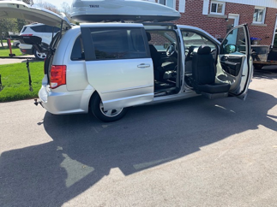
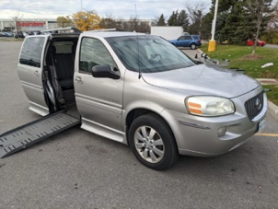
Van Exit Configuration
Two types of accessibility vans, each with different exit points…

Slide 15
Other Accessibility Shortcomings
There are many, many other types of accessibility barriers, such as:
Powered doors opening towards the push button openers
The short length of time doors remain open as someone passes through using a wheelchair, walker or cane
Cross walk lights that don’t provide enough time to cross multi-lane roads
Ramps that are too steep for manual wheelchairs
Uneven sidewalks, and at times a lack of sidewalks along busy streets
Mobility Transportation scheduling and availability and eligibility criteria
Washroom without power doors, inaccessible stalls and wash basins

Slide 16
RESOURCES AND CREDITS
Towards an Accessible Canada - Canada.ca
Accessibility in Ontario | ontario.ca
Accessibility in the public service - Canada.ca
All photo’s taken by MY MS FAMILY members
Authored by Peter Busciglio, MY MS FAMILY President
PowerPoint production by MY MS FAMILY

Slide 17
QUESTIONS?

Slide 18
info@mymsfamily.com | 416-816-4787 | MYMSFamily.com
Notes:
Thank you for engaging in this training. You are deeply appreciated.
I hope we’ve opened your eyes just a little wider than they were when we started. If there’s nothing else you take away today, remember the “CAN and HOW Approach.” Simple. Two, three letter words.
Till next time, take care & God bless.

