Slide 2
INTRODUCTIONS
Rose Paemurd
and
Stephanie Tosky
Notes:
Explain who you are, your background, what you do now….but be sure to explain you are NOT a doctor
For ex:
Spend a great deal of my career working with Doctors, Health Canada officials, healthcare organizations and association, and patient advocacy groups…..
BUT I AM NOT A DOCTOR
I’m speaking to you as a very experienced healthcare executive and I am a woman who educated myself and surrounded myself with experts in this field

Slide 3
WHY DOES UROSPOT EXIST?
To modernize pelvic health and
improve people’s quality of life by
restoring pelvic floor strength

Slide 4
THE SITUATION
An unmet need
People eager to take control of their health
Female empowerment
Femtech (Technology tailored towards Women’s health)
Notes:
The founder had many conversations with medical professionals about why there isn’t a simple and effective solutions for bladder leaks.
She started noticing this problem at 32. She had had 2 babies by age 25…and it started with trying to jump on a trampoline and realizing NOPE! Then it just gradually got worse. Preparing to sneeze or cough. Had pneumonia once and the leaks with coughing were worse than the pneumonia symptoms. Running through airports (which she did all the time with my career). She had to stop doing high intensity workouts, and her biggest love is tennis….coming home near tears because it was just becoming such a frustration when she tried to play. “I think I have to give up tennis??”
Refused to accept that “this was just how it was going to be” – the feminist in me would kick in…I kept saying that if men peed their pants every time they worked out, shot a hockey puck, threw a football, every time they laughed, or coughed or sneezed…..this would have been solved 50 years ago.
It was 2019 and there just had to be a better answer for women….so she went looking for a solution (using my healthcare background)– and found it.
We saw a major gap in the market….so many women (and men) suffering with this….and a very limited offering of “solutions”….all of which were invasive – your clothes are off, someone is touching you and there are hands or instruments going inside you. I just knew there were women like me who wanted an easier, faster and more effective solution.
People eager to take control of their health – strong desire to remain independent longer
Female empowerment – women saying enough! We deserve better…and in healthcare women have been woefully underserved in every aspect of our wellness
Femtech – by women, for women

Slide 5
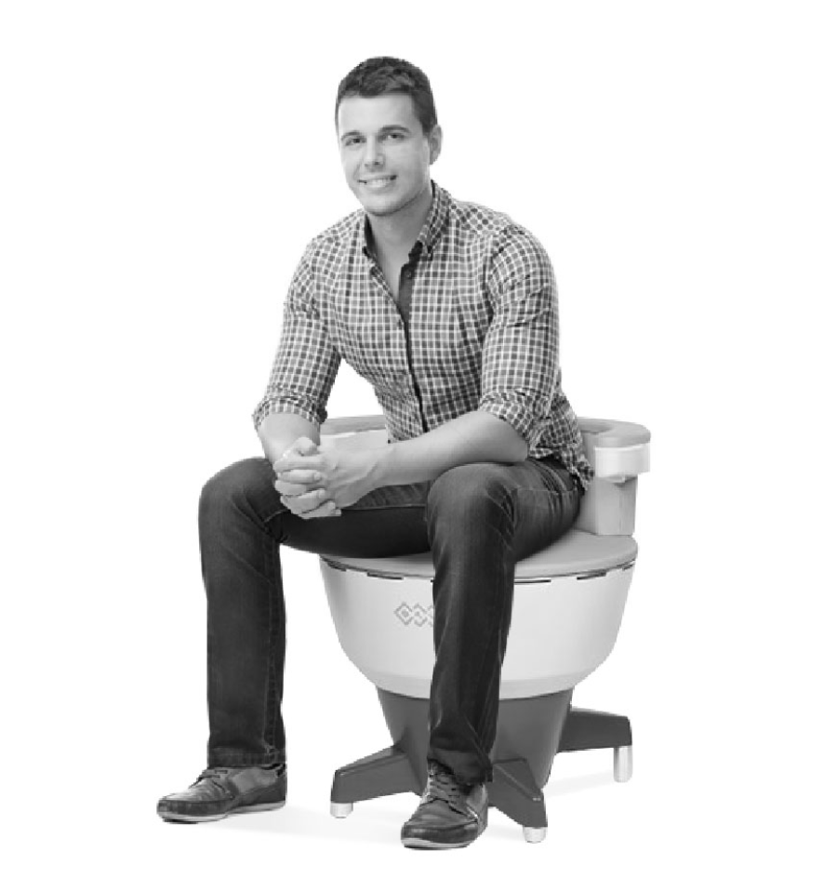
POSITIVE CONSUMER EXPERIENCE
Keep your clothes on.
Sit on the Kegel Throne.
Read a magazine.
Our technology will...
Give women and men freedom from incontinence and erectile dysfunction
by delivering
11,000 Kegels in 28 minutes with
a non-invasive, pain free experience.
Notes:
We realized that people in Canada and the US had access to in incredible innovation that was approved by Health Canada and the FDA.
By combining this technology with world class education and health coaching we knew we could change how pelvic health is treated for the better.

Slide 6
WOMEN & MEN ARE AFFECTED IN THREE WAYS
51%
14%
35%
Stress Urinary Incontinence
Urge Urinary Incontinence
Mixed Urinary Incontinence
Women and Men who have a strong urge to go to the bathroom, and urine leaks out before they get there. Tend to be women who go to the bathroom frequently both day and night.
Women and Men who leak urine when sneezing, coughing, jumping, exercising, or any impact or pressure is placed on the pelvic floor.
Women and Men who experience both symptoms of stress and urge incontinence.
Notes:
STRESS – jumping
URGE – what might someone do to decrease trips to the washroom?

Slide 7
THE PROBLEM (SHHHHH!)
Up to 50% of all women over 35 suffer with stress, urge, or mixed incontinence
Women wait 6.5 years on average from first symptom to seeking help.
Incontinence is the top reason women are admitted to nursing homes later in life.
Current wait time to see a Urogynecologist is 2 years in many markets.
Current treatment is invasive with limited effectiveness.
Women think this is a natural part of growing older and suffer in silence.
Only 10-15% undergo treatment.

Slide 8
THE PROBLEM
Treatment for prostate cancer can cause incontinence and ED:
Incontinence impacts 75% of men post prostatectomy
18 months post surgery 60% of men still struggle with ED
Notes:
Nearly 75% of men have incontinence after prostate surgery
This rate drops with each passing month – 6 months still 14%
Invasive treatment for incontinence must wait at least one year post prostatectomy.
Sexual dysfunction post prostatectomy – 18 months post surgery 60% still experiencing ED

Slide 9
THE DOWNWARD SPIRAL
Stress and urge incontinence significantly affect
people’s everyday lives.
Creates discomfort and lack of confidence.
Limits daily activities.
Start avoiding workouts - symptoms are the worst during exercise.
Missing activity long term can lead to mood or other health problems.
Begin wearing protection for their leakage. Every. Single. Day.
They suffer in silence and don’t seek treatment due to embarrassment.
54%
Loss of Confidence
45%
Give up intimacy
Notes:
46% of women give up exercise

Slide 10
WHO SUPPORTS PFMT AS FIRST LINE TREATMENT?
The Canadian Urological Association’s evidence based treatment guidelines for adult incontinence state pelvic floor muscle strengthening should be offered as a
first line therapy for SUI, UUI and MUI.
AHCPR, ACOG, AUA all advocate pelvic floor strengthening as first line treatment for Stress/Urge incontinence.
SUI: Stress urinary incontinence, UUI: urge urinary incontinence, MUI: mixed urinary incontinence
AHCPR: Agency for Healthcare Research and Quality. ACOG: American College for Obstetrics and Gynecology. AUA: American Urological Association

Slide 11
ROLE OF YOUR PELVIC FLOOR
Base of your core
Shelf – supporting internal organs
Birth
Control
Sexual Functioning
Guard & Protect
Notes:
Pelvic floor muscles are normally firm and thick. Just like a trampoline, they can move up and down and have many important functions.
If you think of your pelvic floor like a shelf, it has an important job to support your internal organs.
Pelvic muscles are also important during pregnancy to support the baby and assist in the birthing process.
Normally, pelvic floor muscles contract and tighten when we cough/sneeze/laugh or do any quick movements to prevent urine leakage. The sphincters (muscles wrapping around the urethra and anus) give us conscious control over our bowel and bladder to give us time to reach the bathroom. With weakened pelvic floor muscles, we lose that control.
Pelvic floor muscles are also important for sexual function. These are the muscles that contract to allow for orgasm. In men, the pelvic floor is important for erectile function and ejaculation. In women, voluntary contractions (squeezing) of the pelvic floor contribute to sexual sensation and arousal.
Pelvic floor muscles also contribute to core strength. They work with your abdominal and back muscles to stabilize and support the spine.
Pelvic floor also has a role to guard and protect – for example if you have a bladder infection or yeast infection it will actually tighten up to try and protect bacteria from getting where it shouldn’t – personal example when I had incontinence.

Slide 12
CAUSES OF PELVIC FLOOR WEAKNESS
Childbirth and pregnancy
Age - menopause
Prolapse – all women must know this!
Straining / chronic constipation
Hysterectomy in women, prostatectomy in men
Notes:
There are many causes of weakened pelvic muscles.
As we age, the tone of these muscles loosens and relaxes.
Childbirth and pregnancy can result in weakness or damage to the pelvic floor, especially due to large birth weight of the baby, multiple or traumatic pregnancies and tears.
Women with weakened pelvic floors may experience pressure or heaviness in their genital area, as the organs “sag” out of place. This is known as a prolapse, where one or more of the pelvic organs bulges into the vagina.
Straining or chronic constipation can weaken the pelvic muscles, as well as chronic coughing and obesity.
Certain surgical procedures such as prostatectomy in men (removal of prostate) and hysterectomy in women (removal of uterus/ovaries) can also weaken the pelvic floor and impact control of the bladder/bowels.

Slide 13
WHAT IS OFFERED TODAY FOR FIRST LINE TREATMENT?
Treatment Guidelines State:
Pelvic floor muscle training (PFMT) is the first line of treatment for those struggling with incontinence
Source: Evidenced based medicine treatment guidelines for Urinary Incontinence from the Canadian Urological Association.

Slide 14
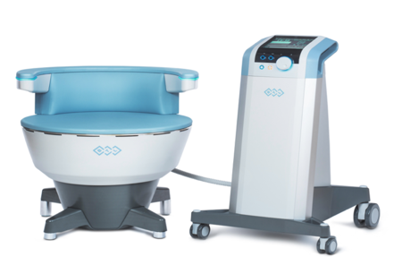
THE SOLUTION: UROSPOT
Breakthrough treatment for bladder leaks and sexual functioning.
Disruptive technology using High Intensity Focused Electromagnetic technology (HIFEM).

Slide 15
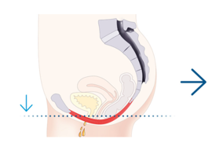
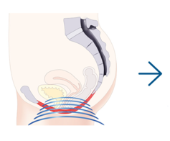
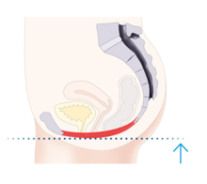
HOW DOES IT WORK?
Highly powerful
High intensity
28 minute session
and focused electromagnetic field is generated.
enables the chair to produce “supramaximal” muscle contractions all while the client sits comfortably, and fully clothed on the chair.
on the chair delivers 11,000 of the strongest Kegels possible.
Notes:
WHAT DOES IT FEEL LIKE?

Slide 16
CLINICAL STUDY
HIFEM Technology Can Improve Quality Of Life
95%
2/3
of treated patients improved quality of life
of treated patients totally eliminated or reduced use of hygienic pads
Investigators: Joseph Berenholz, MD, Michigan, USA and Tracey Sims, MD; George Botros, MD, Liverpool, UK
Notes:
We are always very careful to manage client expectations especially when clients have other conditions.
For clients with Neurological Conditions:
IF: A client presents with a neurological condition (Stroke, Parkinson's, Multiple Sclerosis, spinal cord Injuries, or surgeries, or central nervous system tumors, etc.)
THEN: They may not be the best candidate for treatment. While having a strong pelvic floor can help with leaks and urgency, if the issue is strictly neurological, treatment at UROSPOT will likely not help.
ACTION: Manage expectations carefully. We can help strengthen their pelvic floor as a “back up mechanism” but overall, they likely won’t see full benefit.

Slide 17
UROSPOT MS DATA RESULTS
GENERAL INFORMATION
Data was collected from the completed charts of 8 different UROSPOT clinics, between June 2022 and January 2024.
There were 28 Clients, previously diagnosed with MS, who completed 6 UROSPOT treatments.
The average age of the Clients was 53.5 years.
Notes:
Locations and the number of Clients included in the data: London (6), Barrie (4), Oakville(3), Edmonton(2), Calgary (6), Ottawa(2), Whitby(1), and Kitchener(4).

Slide 18
UROSPOT MS DATA RESULTS
GENERAL INFORMATION
11% identified as male and 89% as female.
The most common reasons for seeking treatment were for Urinary Incontinence, Frequency, Stress Urinary Incontinence and Nocturia.
Notes:
Urinary Incontinence- 89%, Frequency- 86%, Stress Urinary Incontinence- 86%, Nocturia-79%, Incomplete Emptying- 71%, Sexual Dysfunction-25%, General Leaks- 25%, Bowel Incontinence- 29% and Prolapse- 21%.

Slide 19
UROSPOT MS DATA RESULTS
CHOSEN CARE PATHWAY
68%
32%
Chose to do treatment in the Physio Stream
Chose to do treatment
in the Freedom Stream
Data collected by UROSPOT from completed charts at 8 clinics between June 2022 and January 2024

Slide 20
UROSPOT MS DATA RESULTS
HIFEM Technology Can Improve Quality Of Life
95%
78%
of Physio patients
of Freedom patients
reported improved quality of life improvements
at session 6
Data collected by UROSPOT from completed charts at 8 clinics between June 2022 and January 2024

Slide 21
GOVERNMENT APPROVALS
Approved to provide entirely non-invasive
electromagnetic stimulation of pelvic floor musculature for the purpose of rehabilitation of weak pelvic muscles and restoration of neuromuscular control for the treatment of urinary incontinence in women and men.
Approved to provide stimulation
of neuromuscular tissue. Neuromuscular stimulation results in pelvic floor muscle strengthening for the treatment of urinary incontinence in men and women.
Notes:
Dr. Badalian believes the BTL EMSella, which arrived on the scene after the study referenced above, is the future, with its high effectiveness rating and the fact that it could eliminate both the high cost of surgery and recovery time for the patient.

Slide 22
PROTOCOL
11,000
KEGELS
28
MINUTES
6
SESSIONS
1
SIDE EFFECT

Slide 23
UROSPOT EXPERIENCE
Technology
Health Coaching
Education
Notes:
What makes UROSPOT different?
We combine the best in technology with world class pelvic health education and health coaching to improve quality of life.
And we do ALL of this while you remain fully clothed.
We have treated over 12000 clients across all our locations.
We also have an intradisciplinary team of nurses, pelvic health physiotherapists, OBGYN Medical Director - together we offer modern physiotherapy that can be partially covered by benefits.

Slide 24
UROSPOT EXPERIENCE
CONSULTATION
RESTORE YOUR FLOOR
ENJOY YOUR FREEDOM
MAINTAIN THE RESULTS
Notes:
WITH HEALTH CARE PROFESSIONALS

Slide 25
FOR MORE INFORMATION CONTACT ROSE AT rose@urospot.com Mobile 705.795.7867
Notes:
Questions

